Slide 1

Project 3
Proposal
The Job Seeking Word Scraper
Team Members
Emily Coxon
Sandra Reyes
Jonathon Wood
https://github.com/jonowood/Project_3

Slide 2
Project objective
The project objective is to assist job seekers in finding a job. Scraped data will be used to analyse the most popular requirements for certain fields to help job seekers identify which jobs they are qualified for, or necessary skills they may need to obtain.

Slide 3
Project overview
Data Sourcing - Webscraping using BeautifulSoup
Data Warehousing - MongoDB Database
Plotting and User Endpoint - We will plot the scraped data to various visuals using Leaflet & Plotly. We will then display them to the end user via a Interactive Website (Incorporating Flask, HTML/CSS, JavaScript.
Styling - We will use the SemanticUI JavaScript Library to help create a beautiful, responsive layout for our site.

Slide 4




Data Sources
Using BeautifulSoup we will webscrape job listings for Seek, Jora & Indeed.
The scraped data will be stored in a MongoDB database for manipulation and plotting.
1
2
3

Slide 5
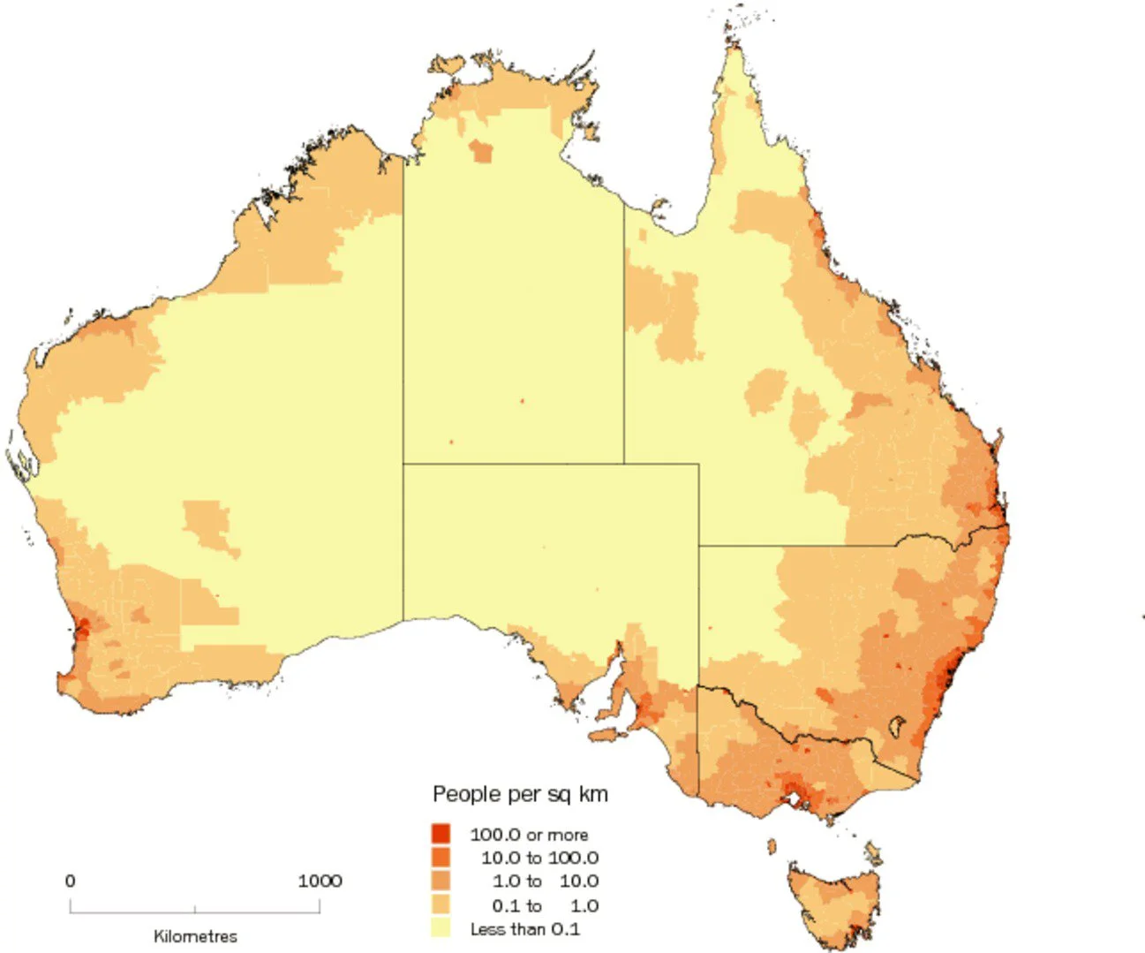
Dashboard visualisations
Choropleth Map A choropleth map identifying the highest concentration of job postings will be produced based on the field in which the job seeker chooses.
Jobs per sq km

Slide 6

Dashboard visualisations
Word Cloud A word cloud identifying the most common phrases will be produced based on the field in which the job seeker chooses.

Slide 7
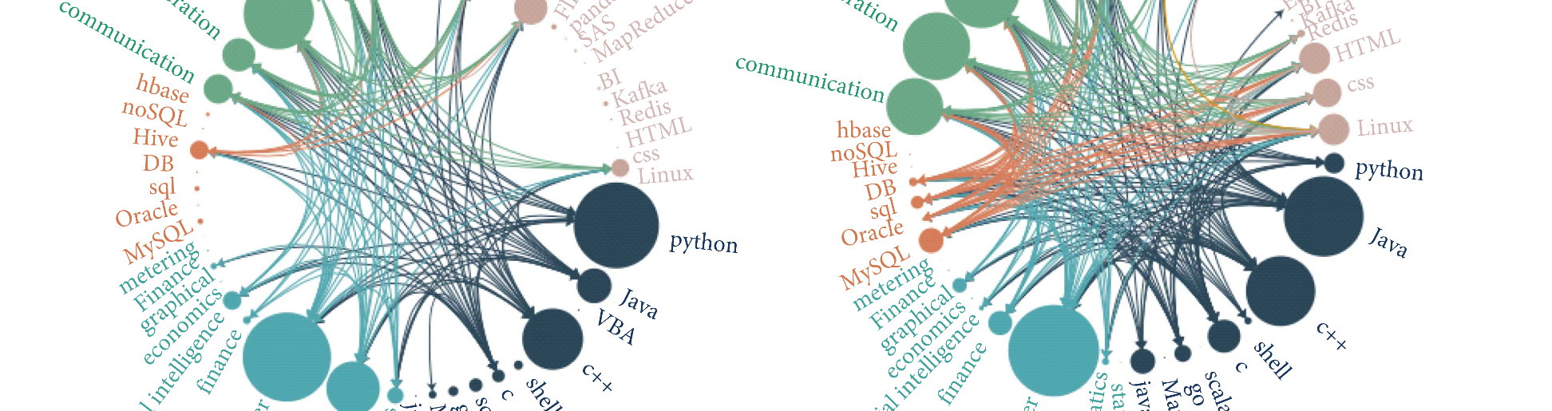
Dashboard visualisations
Dendrogram A dendrogram plot identifying the most common phrases will be produced based on the field in which the job seeker chooses. This field is selected interactively on the plot itself, filtering the common phrases associated with that field.

Slide 8
Thank you.

